Slide 1
Text Mining Analysis on Yelp Restaurant Reviews and Rating Prediction
Master Final Oral Exam
Wei Hu
Major Professor: M.Q. Meeker
04-12-2017

Slide 2
Table of Content
Introduction
Background of Text Mining
Data Description
Preprocessing
Feature Extraction
Predictive Analysis
Conclusion
Iowa State University
Department of Statistics

Slide 3
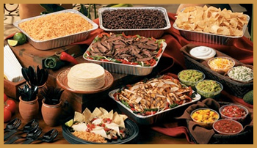






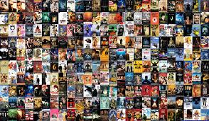


Today online customer reviews provide much larger review coverage and convenient access for potential customers
Iowa State University
Department of Statistics

Slide 4
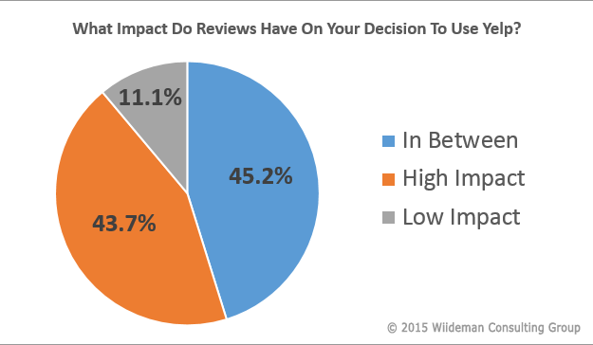
Online customer reviews have tremendous impacts on reputation and revenue of products and local businesses
San Francisco metropolitan area, a rating increase from 3.5 to 4 can cause restaurants to sell out table reservations 19% more frequently
Another study in the Seattle area found that a one-star increase in Yelp rating leads to a 5 to 9 percent increase in revenue for non-chain restaurants and an increasing Yelp coverage to the local market actually can cause a market share decline for the chain restaurants
https://www.wiideman.com/blog/local-seo/study-how-important-are-yelp-reviews-really
Anderson, M. and Magruder, J. (2012), Learning from the crowd: Regression discontinuity estimates of the effects of an online review database,
The Economic Journal, 563, 957–989
Luca, M. (2011), Reviews, Reputation, and Revenue: The Case of Yelp.com, Harvard Business School NOM Unit Working Paper No. 12-016
Iowa State University
Department of Statistics

Slide 5
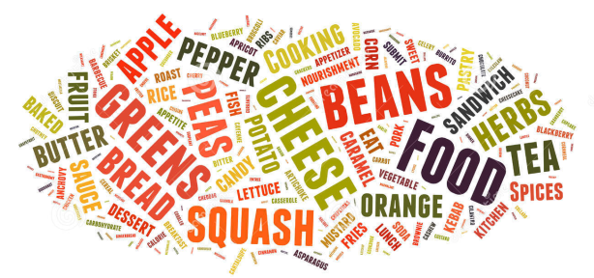


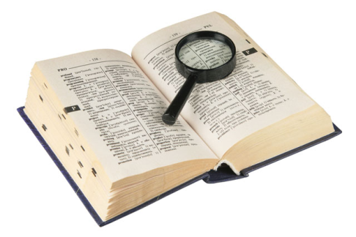
Subjects of text mining : words, document, corpus, dictionary
Word
Document
Dictionary: collection of distinct words in a corpus
Corpus
Iowa State University
Department of Statistics

Slide 6
Text Representation: Bag of words
Unigram
First time eating there tonight, and it was a great experience.
The service is terrific and the food is delicious
Word | Frequency
, | 1
. | 2
a | 1
and | 2
delicious | 1
eating | 1
experience | 1
food | 1
great | 1
is | 2
it | 1
service | 1
terrific | 1
the | 2
there | 1
time | 1
tonight | 1
was | 1
The syntax of the sentence is intentionally ignored for simplicity and efficiency
The order of words can be changed without impacting the outcome of vector representation.
Iowa State University
Department of Statistics

Slide 7
Text Representation: Unigram, Bigram and Trigram
Unigram
Bigram
Trigram
Word | Frequency
, | 1
. | 2
a | 1
and | 2
delicious | 1
eating | 1
experience | 1
food | 1
great | 1
is | 2
it | 1
service | 1
terrific | 1
the | 2
there | 1
time | 1
tonight | 1
was | 1
Word | Frequency
, and | 1
. the | 1
a great | 1
and it | 1
and the | 1
delicious . | 1
eating there | 1
experience . | 1
first time | 1
food is | 1
great experience | 1
is delicious | 1
is terrific | 1
it was | 1
service is | 1
terrific and | 1
the food | 1
the service | 1
there tonight | 1
time eating | 1
tonight , | 1
was a | 1
Word | Frequency
, and it | 1
. the service | 1
a great experience | 1
and it was | 1
and the food | 1
eating there tonight | 1
experience . the | 1
first time eating | 1
food is delicious | 1
great experience . | 1
is delicious . | 1
is terrific and | 1
it was a | 1
service is terrific | 1
terrific and the | 1
the food is | 1
the service is | 1
there tonight , | 1
time eating there | 1
tonight , and | 1
was a great | 1
Iowa State University
Department of Statistics

Slide 8
Iowa State University
Department of Statistics

Slide 9
Iowa State University
Department of Statistics

Slide 10
Iowa State University
Department of Statistics

